Slide 1
Đỗ Hải Sơn
TRICE: A Channel Estimation Framework for
RIS-Aided Millimeter-Wave MIMO Systems¹
¹ : K. Ardah, S. Gherekhloo, A. L. F. de Almeida and M. Haardt, "TRICE: A Channel Estimation Framework for RIS-Aided Millimeter-Wave MIMO Systems,“ in IEEE Signal Processing Letters, vol. 28, pp. 513-517, 2021, doi: 10.1109/LSP.2021.3059363.

Slide 2
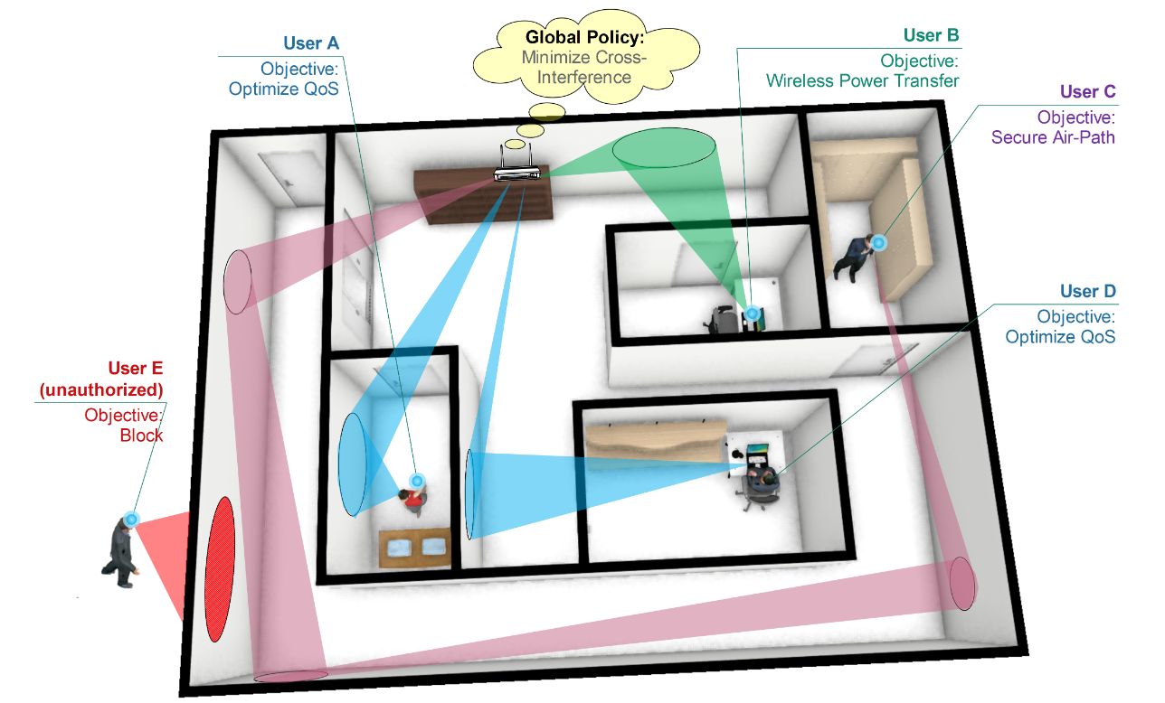
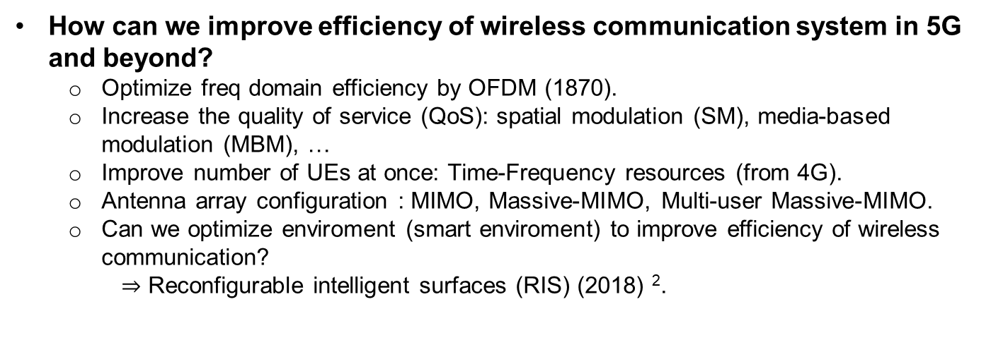
Question?
How can we improve efficiency of wireless communication system in 5G and beyond?
Optimize freq domain efficiency by OFDM (1870).
Increase the quality of service (QoS): spatial modulation (SM), media-based modulation (MBM), …
Improve number of UEs at once: Time-Frequency resources (from 4G).
Antenna array configuration : MIMO, Massive-MIMO, Multi-user Massive-MIMO.
Can we optimize enviroment (smart enviroment) to improve efficiency of wireless communication?
$⇒$ Reconfigurable intelligent surfaces (RIS) (2018) ².
² : C. Liaskos, S. Nie, A. Tsioliaridou, A. Pitsillides, S. Ioannidis and I. Akyildiz, "A New Wireless Communication Paradigm through
Software-Controlled Metasurfaces," in IEEE Communications Magazine, vol. 56, no. 9, pp. 162-169, Sept. 2018.

Slide 3
Outline
Channel Estimation
RIS-Aided Wireless Communications
Two-Stage RIS-Aided MIMO Channel
Estimation (TRICE)
Conclusion

Slide 4
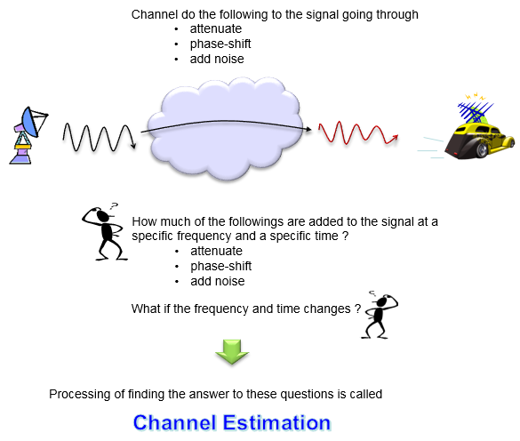
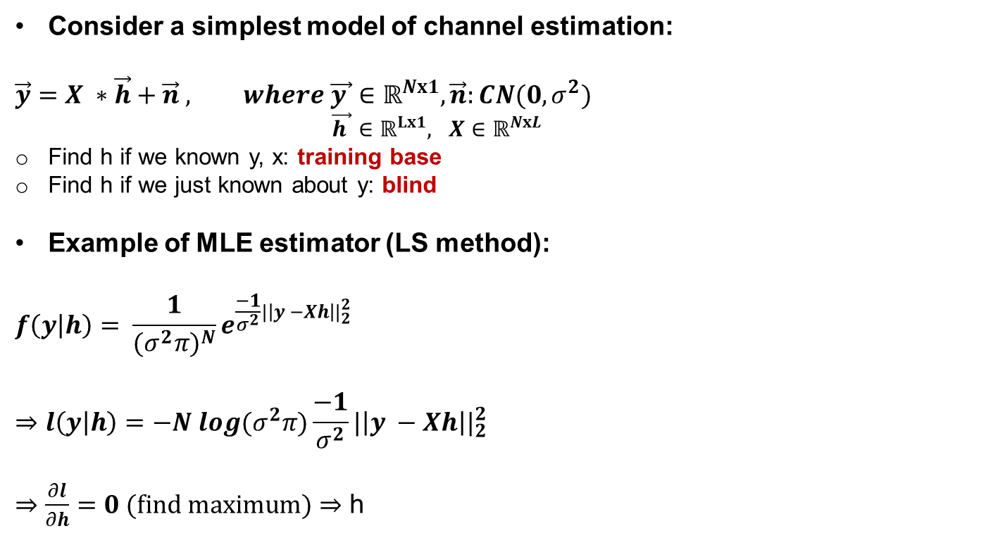
I. Channel Estimation
II. RIS-Aided
III. TRICE
IV. Conclusion
I. Channel Estimation
Consider a simplest model of channel estimation:
$$\vec{y}=X ∗\vec{h}+\vec{n} , where \vec{y }∈ℝ^{Nx1}, \vec{n}:CN(0, σ^{2})$$
$\vec{h }∈ℝ^{Lx1}, X∈ℝ^{NxL}$
Find h if we known y, x: training base
Find h if we just known about y: blind
Example of MLE estimator (LS method):
$$f\left(y | h\right)= \frac{1}{{(σ^{2}π)}^{N}}e^{\frac{−1}{σ^{2}}{|\left|y −Xh\right||}_{2}^{2}}$$
$$⇒l\left(y | h\right)=−N log(σ^{2}π)\frac{−1}{σ^{2}}{|\left|y −Xh\right||}_{2}^{2}$$
$⇒$ $\frac{∂l}{∂h}=0 (find maximum)$ $⇒$ h

Slide 5
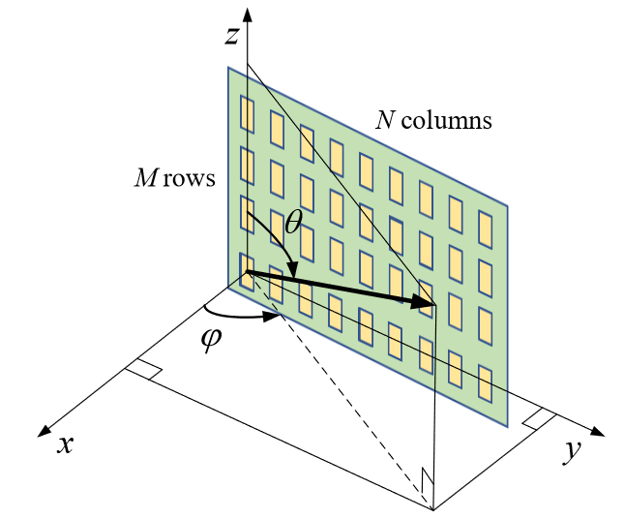
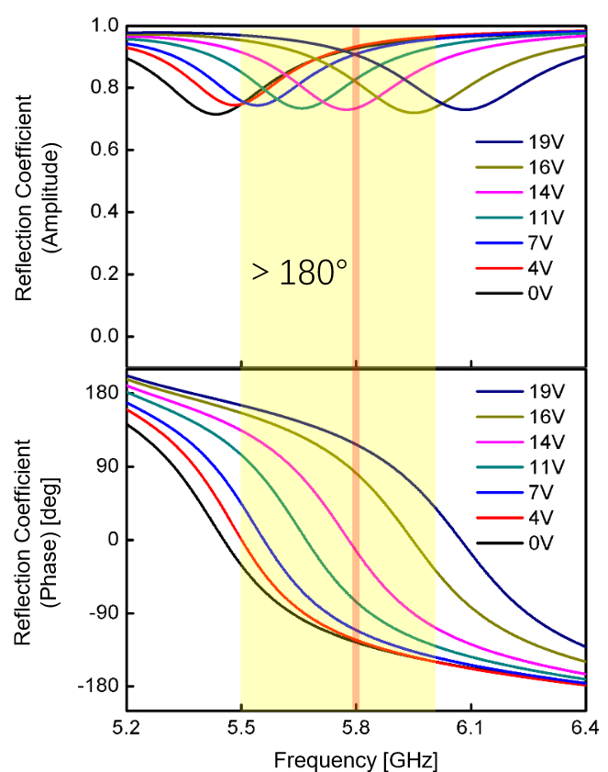
I. Channel Estimation
II. RIS-Aided
III. TRICE
IV. Conclusion
II. RIS-Aided ³
Metasurface tuned by varactor diodes with vertical and horizontal spacings are smaller than half the wavelength.
Varying the bias voltage from 0 to 19 V is sufficient to modify the phase-shift by at least 180 degrees.
Each elements in RIS turns phase of TX-RIS (beamforming) to optimize value of SNR in RX by Varying the bias voltage.
³ : PEI, Xilong, et al., " RIS-aided wireless communications: Prototyping, adaptive beamforming, and indoor/outdoor field trials., " arXiv preprint arXiv:2103.00534, 2021.

Slide 6
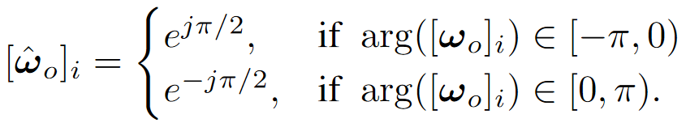
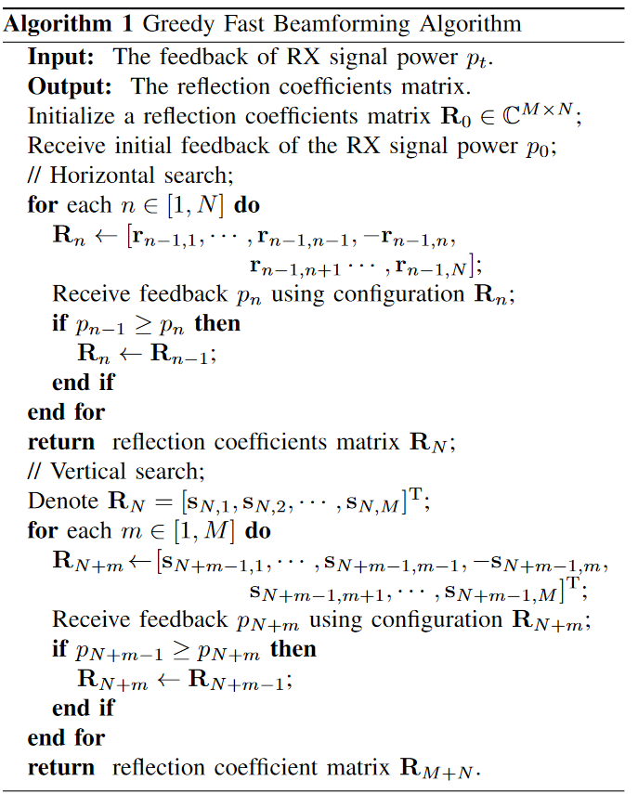
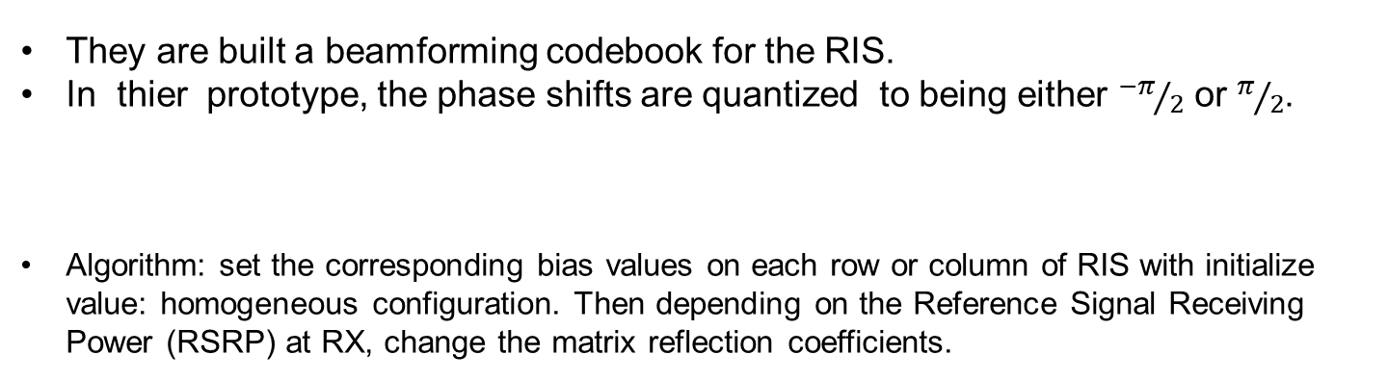
I. Channel Estimation
II. RIS-Aided
III. TRICE
IV. Conclusion
II. RIS-Aided ³
They are built a beamforming codebook for the RIS.
In thier prototype, the phase shifts are quantized to being either ${−π}/2$ or $π/2$.
Algorithm: set the corresponding bias values on each row or column of RIS with initialize value: homogeneous configuration. Then depending on the Reference Signal Receiving Power (RSRP) at RX, change the matrix reflection coefficients.
³ : PEI, Xilong, et al., " RIS-aided wireless communications: Prototyping, adaptive beamforming, and indoor/outdoor field trials., " arXiv preprint arXiv:2103.00534, 2021.

Slide 7
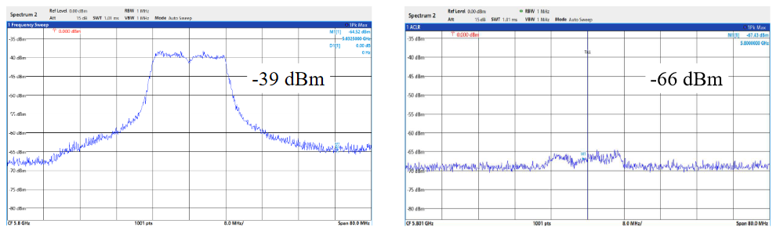
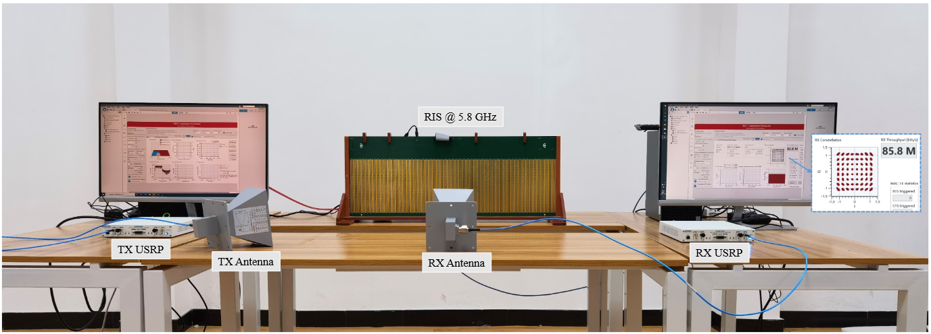
I. Channel Estimation
II. RIS-Aided
III. TRICE
IV. Conclusion
II. RIS-Aided ³
Experimental results: their RIS prototype provides a 26dB power gain compared to the baseline case where the RIS is replaced by a copper plate.
A 27 dB power gain was observed in the short-distance outdoor measurement.
³ : PEI, Xilong, et al., " RIS-aided wireless communications: Prototyping, adaptive beamforming, and indoor/outdoor field trials., " arXiv preprint arXiv:2103.00534, 2021.

Slide 8
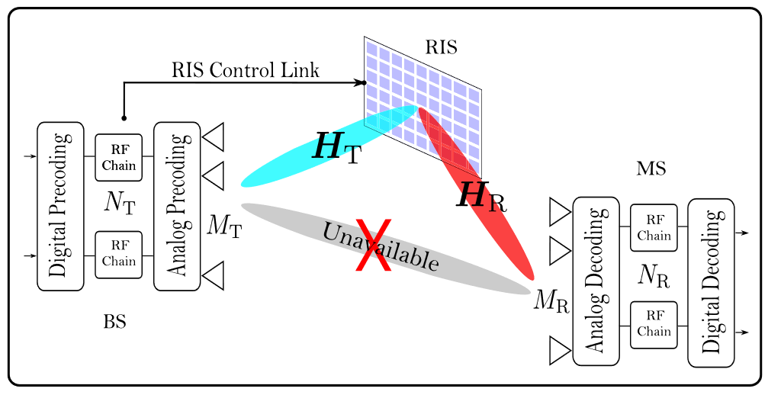
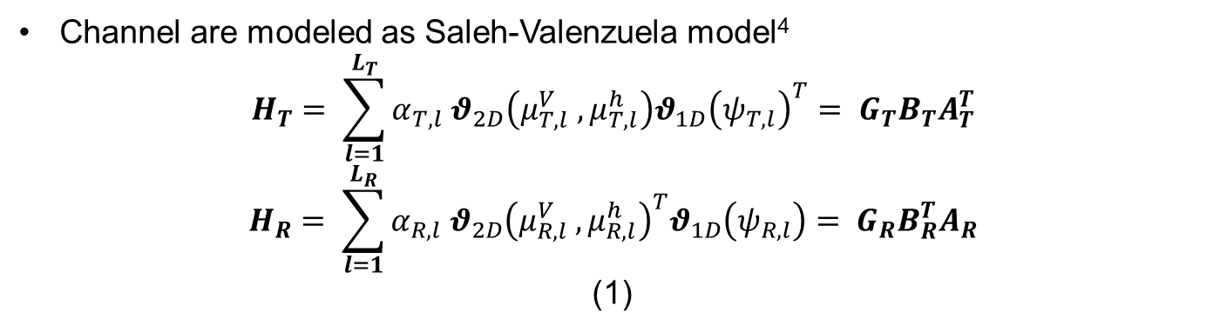
I. Channel Estimation
II. RIS-Aided
III. TRICE
IV. Conclusion
III. Two-Stage RIS-Aided MIMO Channel Estimation (TRICE)
Channel are modeled as Saleh-Valenzuela model⁴
$$H_{T}= \sum_{l=1}^{L_{T}}{α_{T, l} θ_{2D}\left(μ_{T,l}^{V} ,μ_{T,l}^{h}\right){θ_{1D}\left(ψ_{T, l}\right)}^{T}= G_{T}B_{T}A_{T}^{T}}$$
$$H_{R}= \sum_{l=1}^{L_{R}}{α_{R, l} {θ_{2D}\left(μ_{R,l}^{V} ,μ_{R,l}^{h}\right)}^{T}θ_{1D}\left(ψ_{R, l}\right)= G_{R}B_{R}^{T}A_{R}}$$
(1)
⁴ : A. A. M. Saleh and R. Valenzuela, "A Statistical Model for Indoor Multipath Propagation," in IEEE Journal on Selected Areas in
Communications, vol. 5, no. 2, pp. 128-137, February 1987, doi: 10.1109/JSAC.1987.1146527.

Slide 9
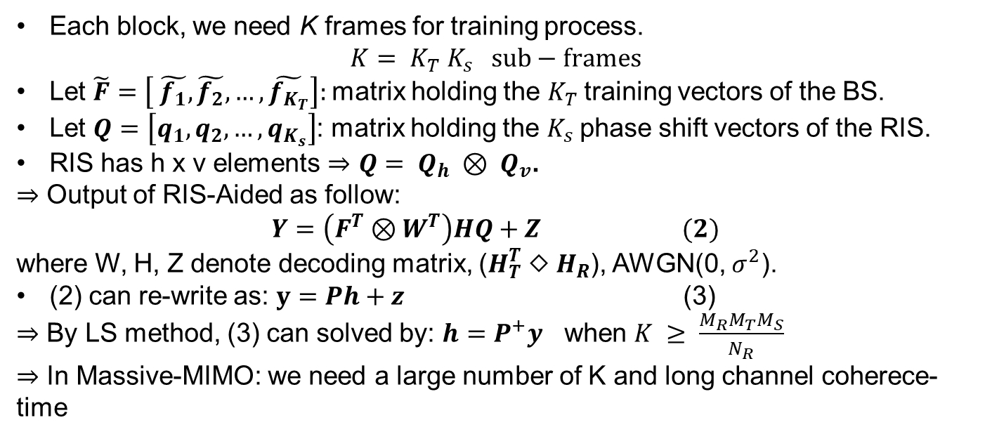
I. Channel Estimation
II. RIS-Aided
III. TRICE
IV. Conclusion
III. Two-Stage RIS-Aided MIMO Channel Estimation (TRICE)
Each block, we need K frames for training process.
$$K= K_{T} K_{s} sub−frames$$
Let $\tilde{F}=\left[ \tilde{f_{1}},\tilde{f_{2}},…,\tilde{f_{K_{T}}}\right]:$matrix holding the $K_{T}$training vectors of the BS.
Let $Q=\left[q_{1},q_{2},…,q_{K_{s}}\right]$: matrix holding the $K_{s}$phase shift vectors of the RIS.
RIS has h x v elements $⇒$ $Q= Q_{h} ⊗ Q_{v}$.
$⇒$ Output of RIS-Aided as follow:
$$Y=\left(F^{T}⊗W^{T}\right)HQ+Z (2)$$
where W, H, Z denote decoding matrix, ($H_{T}^{T} ◇ H_{R}$), AWGN(0, $σ^{2}$).
(2) can re-write as: $y=Ph+z$ (3)
$⇒$ By LS method, (3) can solved by: $h=P^{+}y$ when $K ≥ \frac{M_{R}M_{T}M_{S}}{N_{R}}$
$⇒$ In Massive-MIMO: we need a large number of K and long channel coherece-time
⁴ : A. A. M. Saleh and R. Valenzuela, "A Statistical Model for Indoor Multipath Propagation," in IEEE Journal on Selected Areas in
Communications, vol. 5, no. 2, pp. 128-137, February 1987, doi: 10.1109/JSAC.1987.1146527.

Slide 10
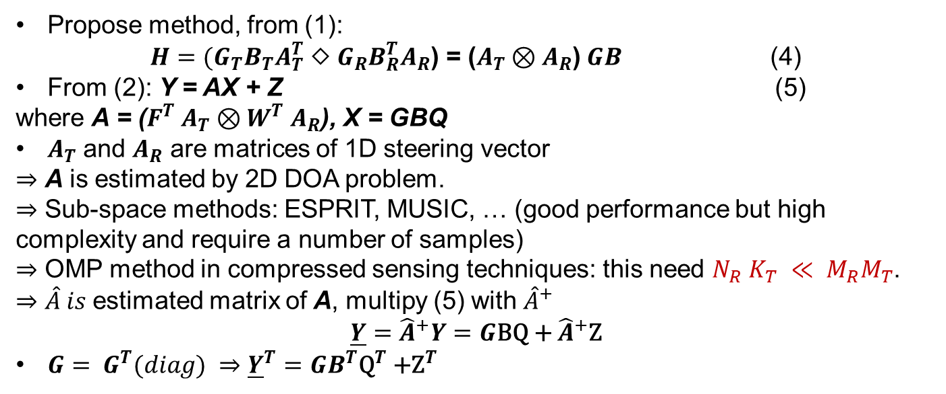
I. Channel Estimation
II. RIS-Aided
III. TRICE
IV. Conclusion
III. Two-Stage RIS-Aided MIMO Channel Estimation (TRICE)
Propose method, from (1):
$H=(G_{T}B_{T}A_{T}^{T}$ $◇$ $G_{R}B_{R}^{T}A_{R}$) = ($A_{T}$ $⊗A_{R}$) $GB$ (4)
From (2): Y = AX + Z (5)
where A = ($F^{T}$ $A_{T}$ $⊗$ $W^{T}$ $A_{R}$), X = GBQ
$A_{T}$ and $A_{R}$ are matrices of 1D steering vector
$⇒$ A is estimated by 2D DOA problem.
$⇒$ Sub-space methods: ESPRIT, MUSIC, … (good performance but high complexity and require a number of samples)
$⇒$ OMP method in compressed sensing techniques: this need $N_{R}$ $K_{T} ≪ M_{R}M_{T}$.
$⇒$ $\hat{A} is$estimated matrix of A, multipy (5) with ${\hat{A}}^{+}$
$$\underline{Y}={\hat{A}}^{+}Y=G\text{BQ}\text{ + }{\hat{A}}^{+}\text{Z}$$
$G= G^{T}(diag) ⇒$ ${\underline{Y}}^{T}=GB^{T}{\text{Q}}^{T}\text{ +}{\text{Z}}^{T}$
⁴ : A. A. M. Saleh and R. Valenzuela, "A Statistical Model for Indoor Multipath Propagation," in IEEE Journal on Selected Areas in
Communications, vol. 5, no. 2, pp. 128-137, February 1987, doi: 10.1109/JSAC.1987.1146527.

Slide 11
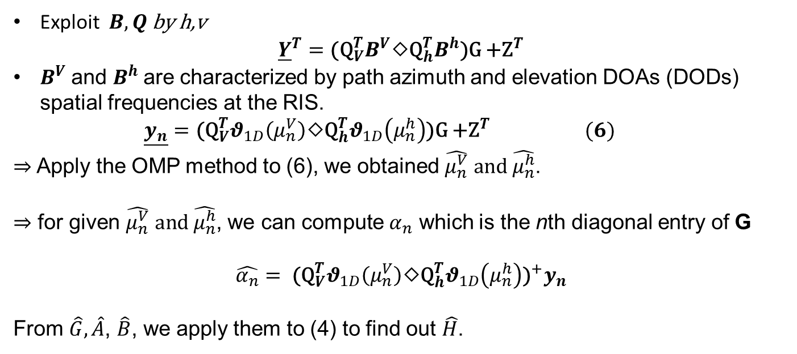
I. Channel Estimation
II. RIS-Aided
III. TRICE
IV. Conclusion
III. Two-Stage RIS-Aided MIMO Channel Estimation (TRICE)
Exploit $B,Q$ by h,v
$${\underline{Y}}^{T}=\text{(}{\text{Q}}_{V}^{T}B^{V}◇{\text{Q}}_{h}^{T}B^{h}\text{)}\text{G}\text{ +}{\text{Z}}^{T}$$
$B^{V}$and $B^{h}$are characterized by path azimuth and elevation DOAs (DODs) spatial frequencies at the RIS.
$$\underline{y_{n}}=\text{(}{\text{Q}}_{V}^{T}θ_{1D}\left(μ_{n}^{V}\right)◇{\text{Q}}_{h}^{T}θ_{1D}\left(μ_{n}^{h}\right)\text{)}\text{G}\text{ +}{\text{Z}}^{T} (6)$$
$⇒$ Apply the OMP method to (6), we obtained $\hat{μ_{n}^{V}} and \hat{μ_{n}^{h}}$.
$⇒$ for given $\hat{μ_{n}^{V}} and \hat{μ_{n}^{h}}$, we can compute $α_{n}$ which is the nth diagonal entry of G
$$\hat{α_{n}}= {{\text{(}\text{Q}}_{V}^{T}θ_{1D}\left(μ_{n}^{V}\right)◇{\text{Q}}_{h}^{T}θ_{1D}\left(μ_{n}^{h}\right)\text{)}}^{+}y_{n}$$
From $\hat{G},\hat{A}$, $\hat{B}$, we apply them to (4) to find out $\hat{H}$.
⁴ : A. A. M. Saleh and R. Valenzuela, "A Statistical Model for Indoor Multipath Propagation," in IEEE Journal on Selected Areas in
Communications, vol. 5, no. 2, pp. 128-137, February 1987, doi: 10.1109/JSAC.1987.1146527.

Slide 12
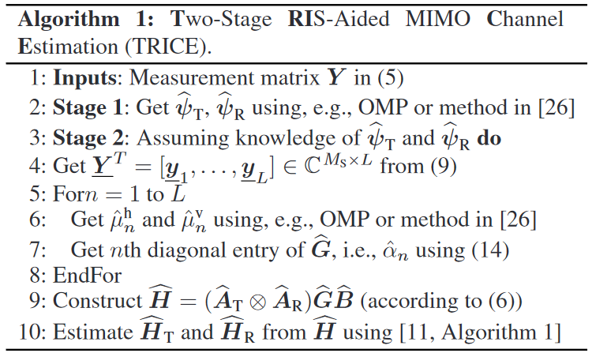
I. Channel Estimation
II. RIS-Aided
III. TRICE
IV. Conclusion
III. Two-Stage RIS-Aided MIMO Channel Estimation (TRICE)
⁴ : A. A. M. Saleh and R. Valenzuela, "A Statistical Model for Indoor Multipath Propagation," in IEEE Journal on Selected Areas in
Communications, vol. 5, no. 2, pp. 128-137, February 1987, doi: 10.1109/JSAC.1987.1146527.

Slide 13
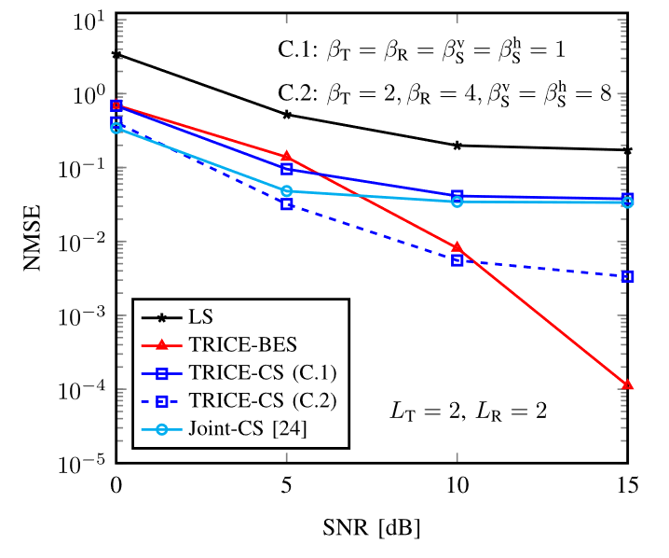
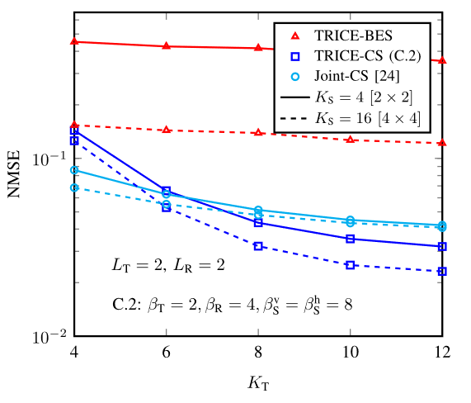
I. Channel Estimation
II. RIS-Aided
III. TRICE
IV. Conclusion
IV. Conclusion
Simulation:

Slide 14


